Slide 1
Introduction to Deep Learning 3
Prof. Luis A. Hernández Gómez
luisalfonso.hernandez@upm.es

Slide 2
Modelling sequences
Applications areas are broad:
Signals: video, speech, sensors,….
Time series: financial series, log messages,..
Sequence of characters: Natural Language Processing,…
Sequences of observations, actions, rewards: Reinforcement Learning (robots, bots, autonomous vehicles, dialog systems..)

Slide 3
Is it always necessary to use dynamic/memory models?
You can see Human Activity Recognition examples at:
https://github.com/MasterMSTC/DeepLearning_TF_Keras
MSTC_HAR_CNN.ipynb
MSTC_Keras_HAR_CNN.ipynb

Slide 4
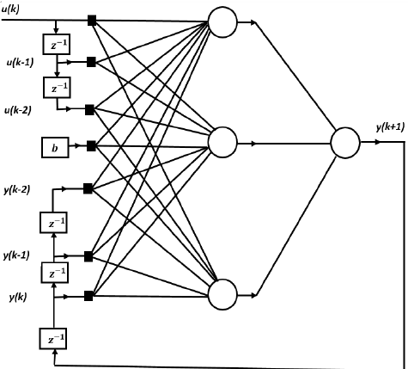
Memoryless models for sequences
NARX model: Nonlinear Auto Regressive Model with external inputs.
Another name: TDNN (time-delay neural network)

Slide 5
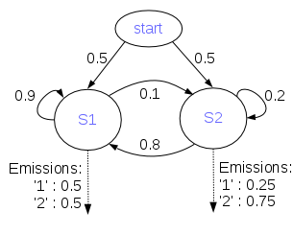
Dynamic Generative Models: as for example Hidden Markov Models
Hidden Markov Models have a discrete one-of-N hidden state.
Transitions between states are stochastic and controlled by a transition matrix.
The outputs produced by a state are stochastic.
A fundamental limitation of HMMs
Consider what happens when a hidden Markov model generates data.
At each time step it must select one of its hidden states.
So with N hidden states it can only remember log(N) bits about what it generated so far.
From: Geoffrey Hinton
CSC2535 2013: Advanced Machine Learning

Slide 6
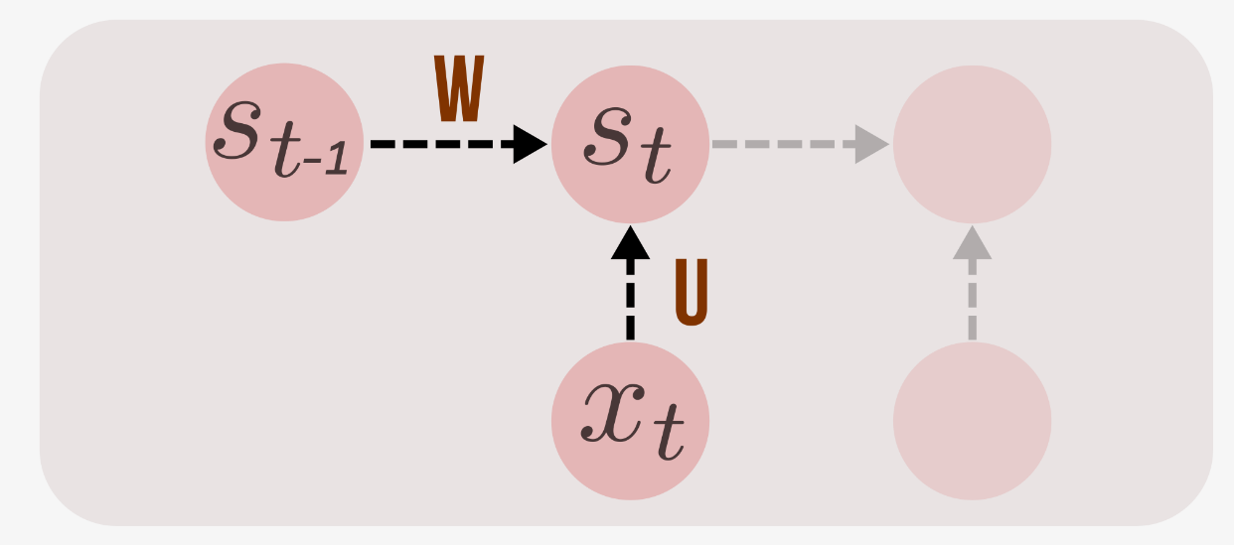
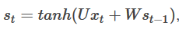
Recurrent Neural Networks (RNN)
RNNs combine the input vector with their state vector with a fixed (but learned) function to produce a new state vector.
http://suriyadeepan.github.io/2017-02-13-unfolding-rnn-2/

Slide 7
Recurrent Neural Networks (RNN)
RNNs are very powerful, because they combine two properties:
Distributed hidden state that allows them to store a lot of information about the past efficiently.
Non-linear dynamics that allows them to update their hidden state in complicated ways.
With enough neurons and time, RNNs can compute anything that can be computed by your computer.
From: Geoffrey Hinton
CSC2535 2013: Advanced Machine Learning

Slide 8
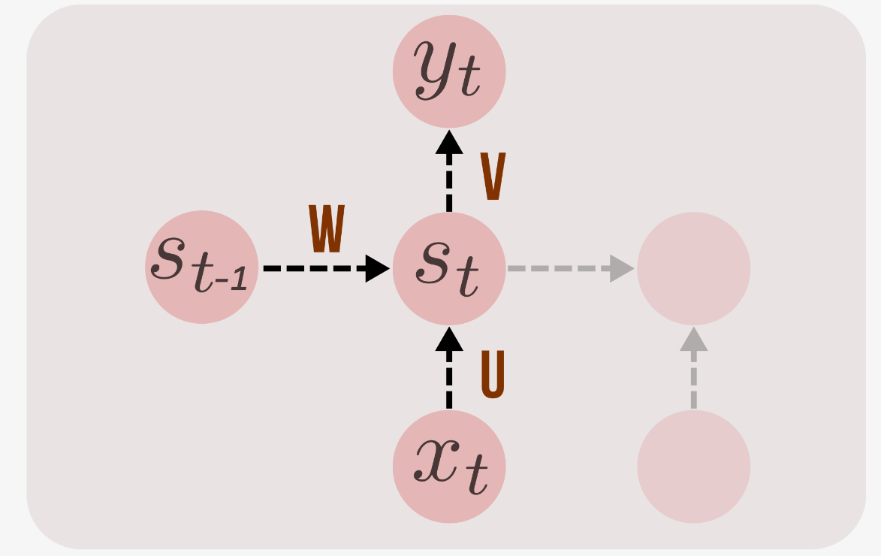
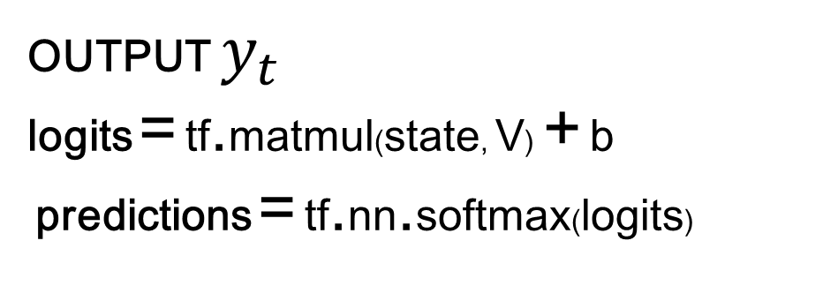
OUTPUT $y_{t}$
logits = tf.matmul(state, V) + b
predictions = tf.nn.softmax(logits)

Slide 9
RNN essentially describe programs:
inputs + some internal variables.
In fact, it is known that RNNs are Turing-Complete in the sense that they can to simulate arbitrary programs (with proper weights).

Slide 10
Neural Turing Machines
Can neural nets learn programs?
Alex Graves
Greg Wayne
Ivo Danihelka

Slide 11
…path to AI??
…. But “ forget I said anything.”
Andrej Karpathy
http://karpathy.github.io/2015/05/21/rnn-effectiveness

Slide 12

Recurrent Neural Networks Applications
Image
description
using text
Emotion
Recognition
Language
Model
Machine
Translation
Video frame
labelling
Phoneme
Recognition

Slide 13
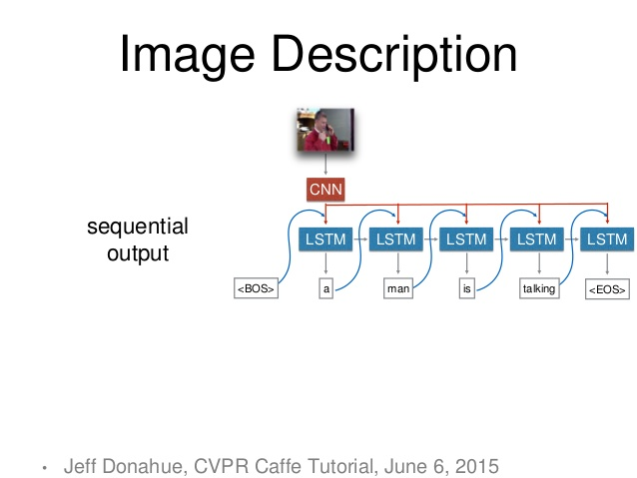

Slide 14
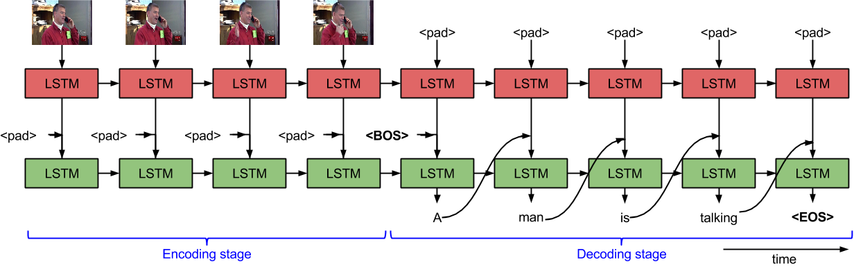
Sequence to Sequence - Video to Text Subhashini Venugopalan, et al.

Slide 15
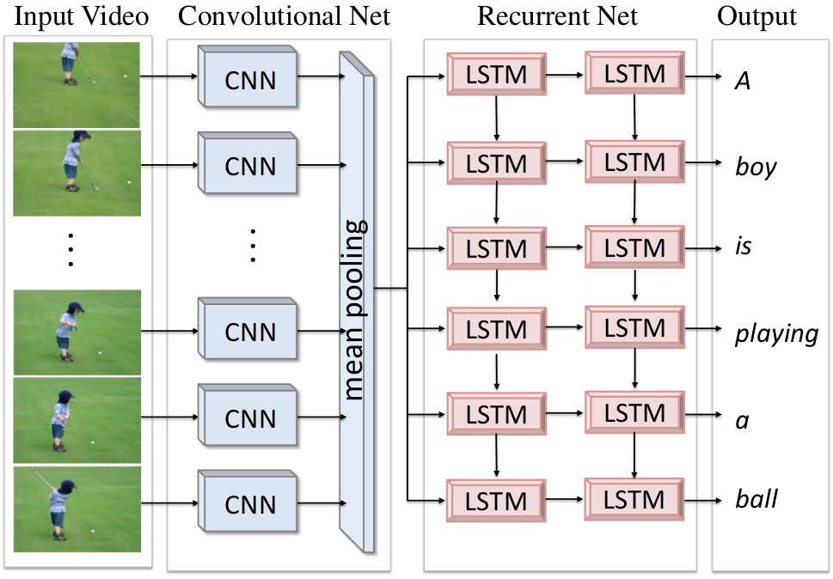
Translating Videos to Natural Language Using Deep Recurrent Neural Networks Subhashini Venugopalan, et al.

Slide 16
Written Memories: Understanding, Deriving and Extending the LSTM
http://r2rt.com/written-memories-understanding-deriving-and-extending-the-lstm.html

Slide 17
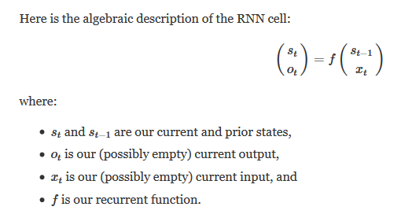

Slide 18
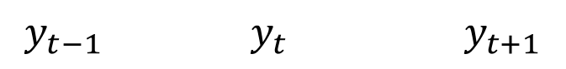
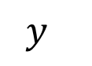
$${ y}_{}$$
$${y_{t−1}{ y}_{t} y}_{t+1}$$

Slide 19
Output sequence
$${y_{t−1}{ y}_{t} y}_{t+1}………$$
Input sequence
$${x_{t−1}{ x}_{t} x}_{t+1}………$$

Slide 20
……
State
sequence!
$${s_{t−1}{ s}_{t} s}_{t+1}………$$

Slide 21
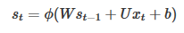
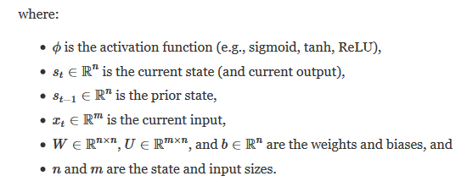
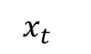
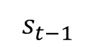
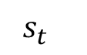
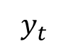
$${{ y}_{t}}_{}$$
$${{ s}_{t}}_{}$$
$${{ s}_{t−1}}_{}$$
$${{ x}_{t}}_{}$$

Slide 22
TRAINING RNN: W, U, V ?
BPTT: Backpropagation Through Time
Truncated

Slide 23
Backpropagation Through Time (BPTT)
Because the parameters are shared by all time steps in the network
The gradient at each output depends not only on the calculations of the current time step, but also the previous time steps.
http://www.wildml.com/2015/09/recurrent-neural-networks-tutorial-part-2-implementing-a-language-model-rnn-with-python-numpy-and-theano/

Slide 24
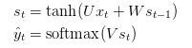
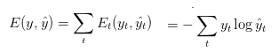

Backpropagation Through Time (BPTT)
Cross entropy loss:
The output value does depend on the state of the hidden layer,
which depends on all previous states of the hidden layer
and thus, all previous inputs

Slide 25
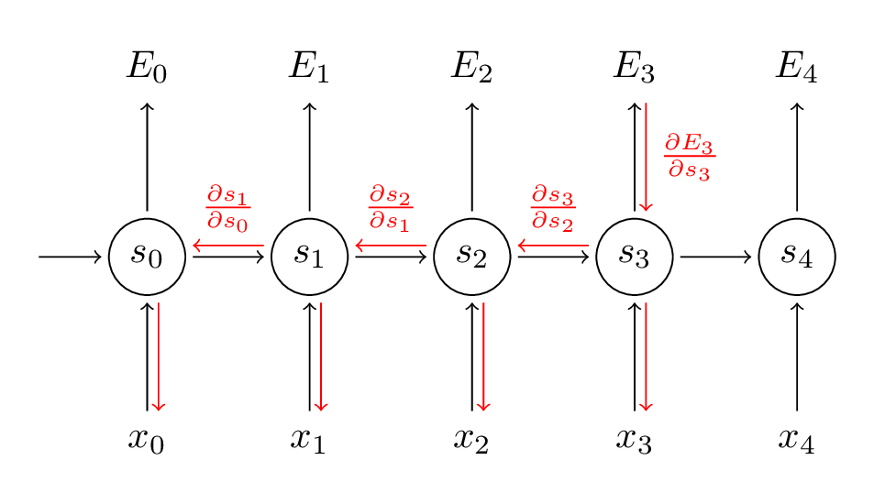
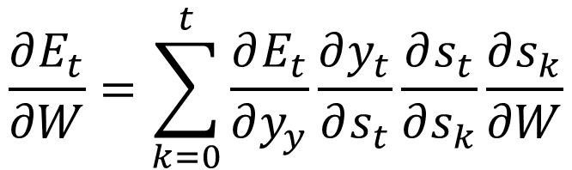
Backpropagation Through Time (BPTT)
But the recurrent net can be seen as a (very deep) feedforward net with shared weights
The forward pass builds up a stack of the activities of all the units at each time step.
The backward pass peels activities off the stack to compute the error derivatives at each time step.
After the backward pass we add together the derivatives at all the different times for each weight
$$\frac{∂E_{t}}{∂W}=\sum_{k=0}^{t}{\frac{∂E_{t}}{∂y_{y}}\frac{∂y_{t}}{∂s_{t}}\frac{∂s_{t}}{∂s_{k}}\frac{∂s_{k}}{∂W}}$$

Slide 26
Styles of Truncated Backpropagation
Tensorflow-style
num_steps

Slide 27
Vanishing gradient problem
In an RNN trained on long sequences (e.g. 100 time steps) the gradients can easily explode or vanish.
Led to the development of LSTMs and GRUs, two of the currently most popular and powerful models
http://www.wildml.com/2015/09/recurrent-neural-networks-tutorial-part-2-implementing-a-language-model-rnn-with-python-numpy-and-theano/

Slide 28

Let’s practices for series prediction
in TensorFlow with a BasicRNNCell
https://github.com/MasterMSTC/DeepLearning_TF_Keras
MSTC_RNN_1_Series.ipynb

Slide 29

Tensorflow RNN static vs. dynamic
Tensorflow contains two different functions for RNNs: tf.nn.rnn and tf.nn.dynamic_rnn.
Internally, tf.nn.rnn creates an unrolled static-graph for a fixed RNN length.
First, graph creation is slow.
Second, you’re unable to pass in longer sequences than you’ve originally specified.
tf.nn.dynamic_rnn solves this. It uses a tf.While loop to dynamically construct the graph when it is executed.
Graph creation is faster;
and you can feed batches of variable size.

Slide 30
Tensorflow RNN static vs. dynamic
What about performance? dynamic is faster?
In short, just use tf.nn.dynamic_rnn. There is no benefit to tf.nn.rnn and I wouldn’t be surprised if it was deprecated in the future.
http://www.wildml.com/2016/08/rnns-in-tensorflow-a-practical-guide-and-undocumented-features/

Slide 31
Tensorflow RNN static vs. dynamic
rnn_inputs are different
rnn_inputs to tf.nn.rnn is a list of tensors
rnn_inputs to tf.nn.dynamic_rnn is:
A Tensor with dimension
[batch_size, n_step, n_input]

Slide 32
See Neural networks and deep learning by Aurélien Géro
https://www.safaribooksonline.com/library/view/neural-networks-and/9781492037354/ch04.html
In particular Fig 4-10 to understand reshape

Slide 33
You can try with financial data (hard) and synthetic signals (easy)
As well as with LSTM and GRU

Slide 34
Now let’s try a simple NLP task
Predicting Text Characters
https://github.com/MasterMSTC/DeepLearning_TF_Keras
MSTC_Keras_RNN_2_Text.ipynb

Slide 35

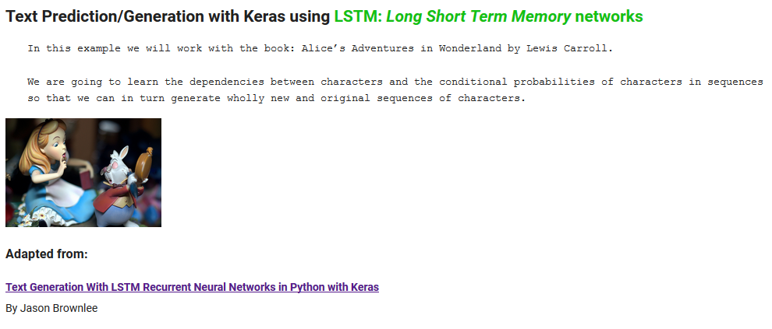
Text prediction & generation using RNN

Slide 36
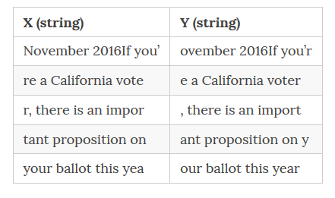
The NLP Task: language modeling to capture the statistical relationship among words / chars
The objective of the network is to observe the input x, one character at a time and produce the output sentence y, one character at a time
http://suriyadeepan.github.io/2017-02-13-unfolding-rnn-2/

Slide 37
Output sequence
……
$${y_{t−1}{ y}_{t} y}_{t+1}………$$
Input sequence
……
$${x_{t−1}{ x}_{t} x}_{t+1}………$$

Slide 38
Now we can test using LSTM or GRU
+ much more to consider…
#Dropout
# Regularization
# Batch normalization
# Adding noise…

Slide 39
RNN are Generative Models
Vanilla (Elman), LSTM or GRU can be used to generate TEXT

Slide 40
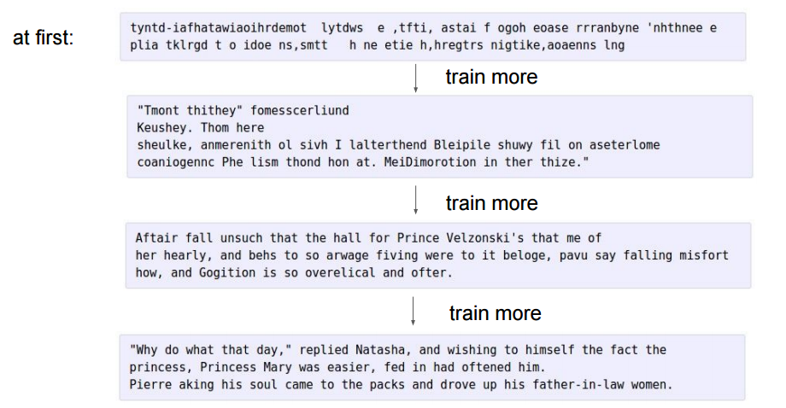
100 th
iteration
300 th
iteration
700 th
iteration
2000 th
iteration
Andrej Karpathy, Blog on “Unreasonable Effectiveness of Recurrent Neural Networks”

Slide 41
Basic concepts: LSTM & GRU
http://colah.github.io/posts/2015-08-Understanding-LSTMs/
Vanishing gradients: a problem?
it may be that for some tasks we want gradients to vanish completely, and for others, it may be that we want them to grow
Are RNNs capable of handling “long-term dependencies?”
Long Short Term Memory networks – LSTMs
Hocreiter and Schmidhuber (1997)

Slide 42
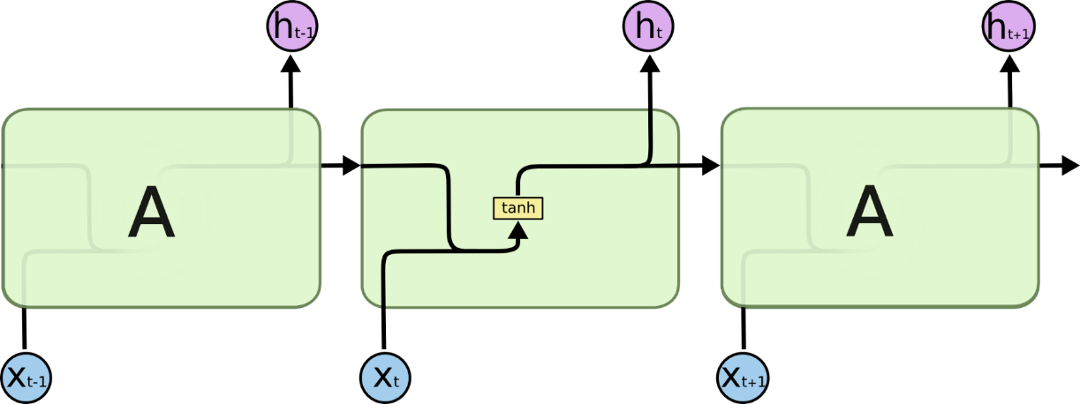
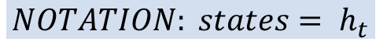
$$NOTATION: states= h_{t}$$
The repeating module in a standard RNN contains a single layer

Slide 43

The repeating module in LSTM contains four interacting layers

Slide 44


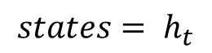
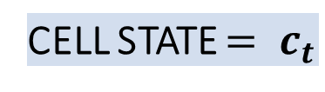
Core Idea Behind LSTM
CELL STATE $= c_{t}$
$$states= h_{t}$$

Slide 45
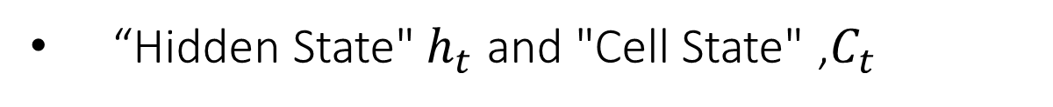
Tensorflow NOTE:
cell = tf.nn.rnn_cell.LSTMCell(state_size, state_is_tuple=True)
“Hidden State"$h_{t}$ and "Cell State" ,$C_{t}$

Slide 46
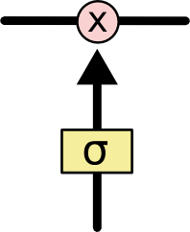
Core Idea Behind LSTM
The LSTM does have the ability to remove or add information to the cell state, carefully regulated by structures called gates.
Gates are a way to optionally let information through.
They are composed out of a sigmoid neural net layer and a pointwise multiplication operation.
A value of zero means “let nothing through,” while a value of one means “let everything through!”
An LSTM has three of these gates, to protect and control the cell state

Slide 47
Basic concepts: LSTM & GRU
Hocreiter and Schmidhuber (1997)
The fundamental principle of LSTMs: to ensure the integrity of our messages in the real world, we write them down
The fundamental challenge of LSTMs and keeping our state under control is to be selective in three things:
what we write (write selectivity),
what we read (because we need to read something to know what to write) (read selectivity)
and what we forget (because obsolete information is a distraction and should be forgotten) (forget selectivity)
Gates as a mechanism for selectivity

Slide 48
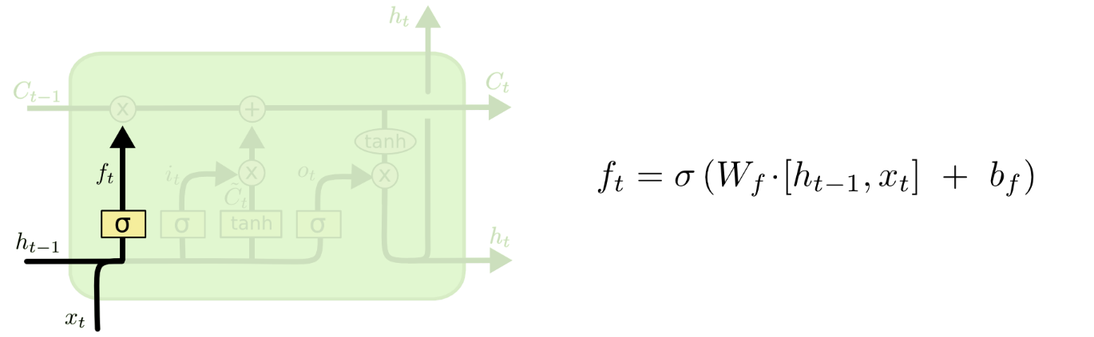
Step-by-Step LSTM Walk Through
Forget gate: The first step in our LSTM is to decide what information we’re going to throw away from the cell state.
When we “see” something new relevant we decide forget….

Slide 49
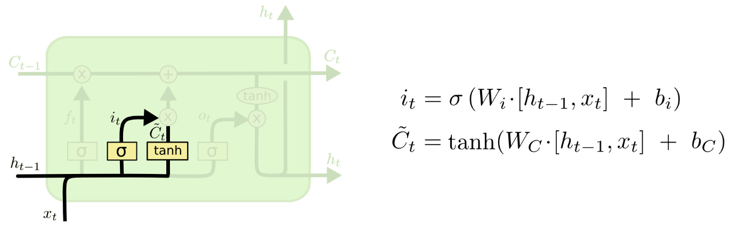
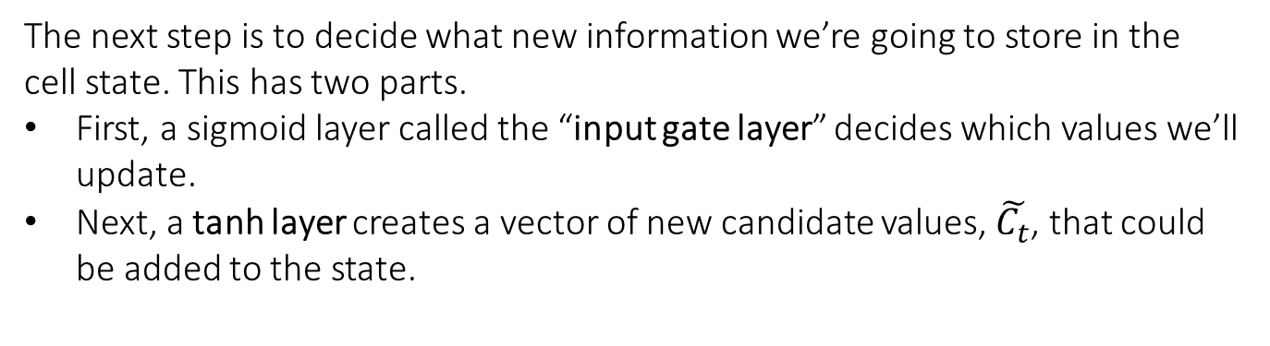
Step-by-Step LSTM Walk Through
The next step is to decide what new information we’re going to store in the cell state. This has two parts.
First, a sigmoid layer called the “input gate layer” decides which values we’ll update.
Next, a tanh layer creates a vector of new candidate values, $\tilde{C_{t}}$, that could be added to the state.

Slide 50
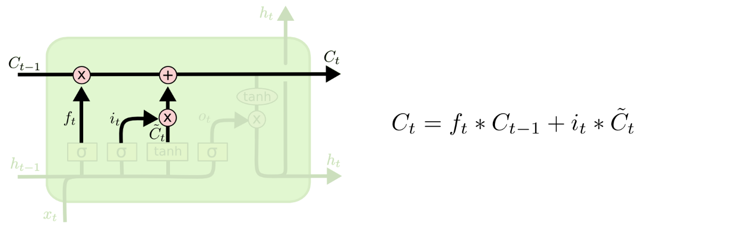
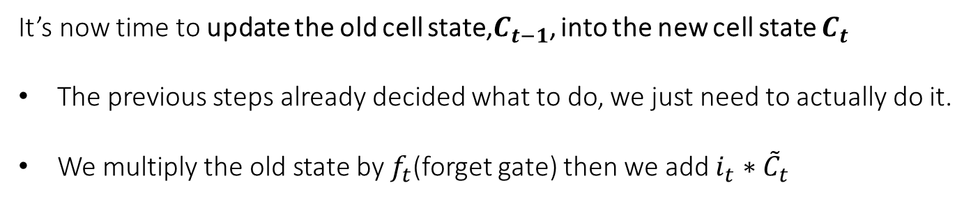
Step-by-Step LSTM Walk Through
It’s now time to update the old cell state,$C_{t−1}$, into the new cell state $C_{t}$
The previous steps already decided what to do, we just need to actually do it.
We multiply the old state by $f_{t}$(forget gate) then we add $i_{t}∗{\tilde{C}}_{t}$

Slide 51
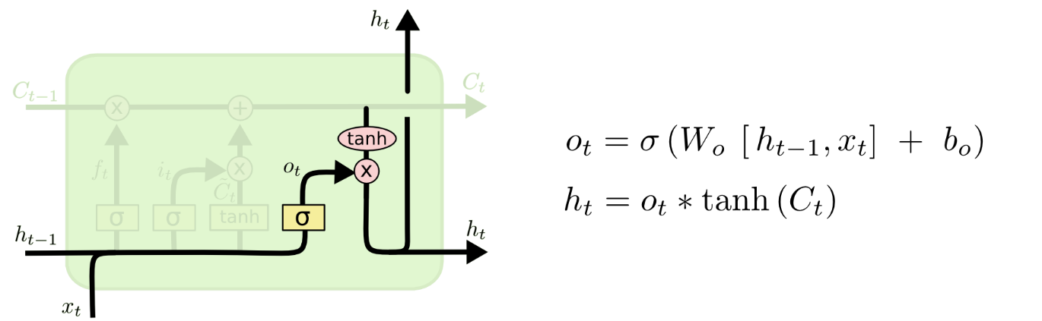
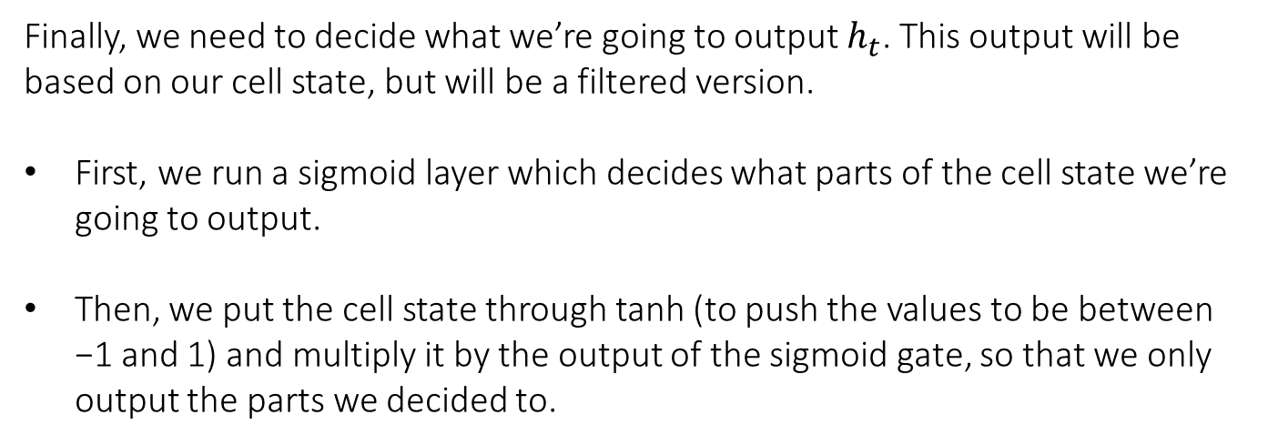
Step-by-Step LSTM Walk Through
Finally, we need to decide what we’re going to output $h_{t}$. This output will be based on our cell state, but will be a filtered version.
First, we run a sigmoid layer which decides what parts of the cell state we’re going to output.
Then, we put the cell state through tanh (to push the values to be between −1 and 1) and multiply it by the output of the sigmoid gate, so that we only output the parts we decided to.

Slide 52
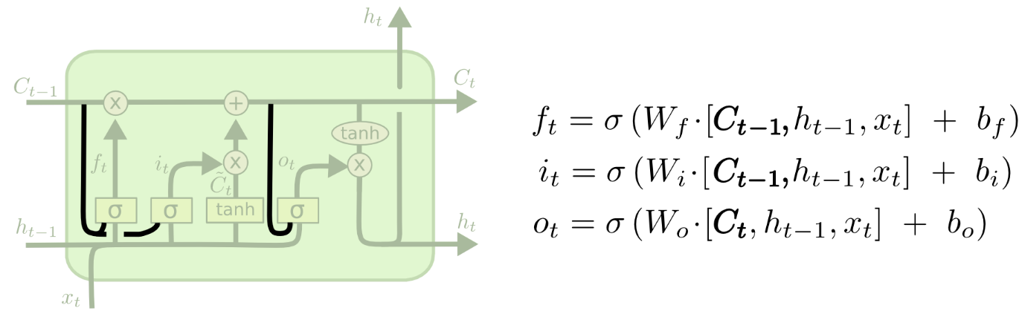
Variants on Long Short Term Memory
One popular LSTM variant, introduced by Gers & Schmidhuber (2000), is adding “peephole connections.”
This means that we let the gate layers look at the cell state.
The above diagram adds peepholes to all the gates, but many papers will give some peepholes and not others.

Slide 53
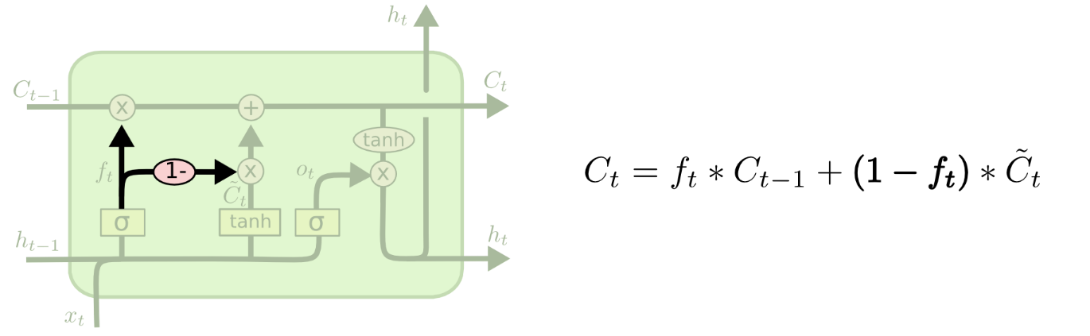
Variants on Long Short Term Memory
Another variation is to use coupled forget and input gates.
We only input new values to the state when we forget something older

Slide 54
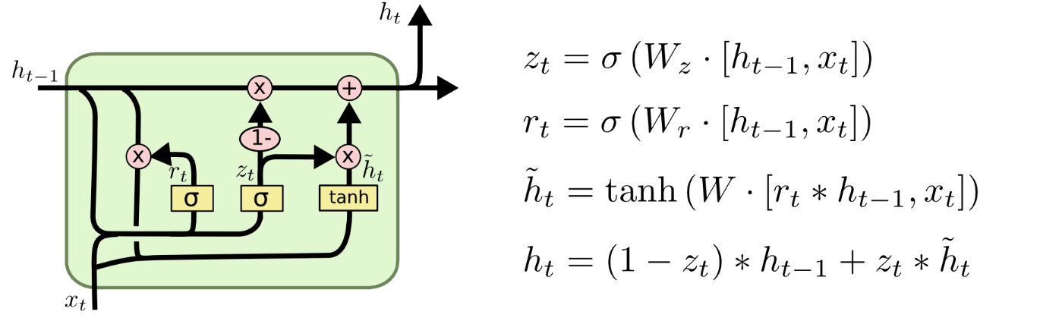
Variants on Long Short Term Memory
Gated Recurrent Unit, or GRU, introduced by Cho, et al. (2014).
It combines the forget and input gates into a single “update gate.”
It also merges the cell state and hidden state, and makes some other changes.
The resulting model is simpler than standard LSTM models, and has been growing increasingly popular.

Slide 55
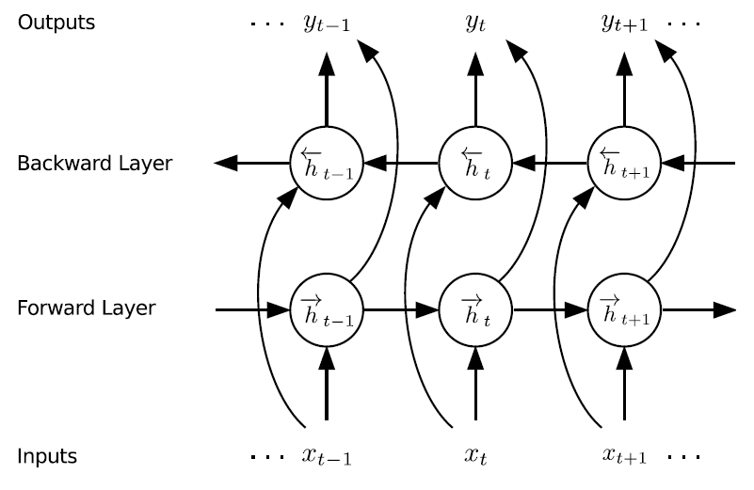
Variants on Long Short Term Memory
These are only a few of the most notable LSTM variants.
See for example: BLSTM Bi-directional LSTM

Slide 56
Variants on Long Short Term Memory
Which of these variants is best? Do the differences matter?
Greff, et al. (2015) do a nice comparison of popular variants, finding that they’re all about the same.
Jozefowicz, et al. (2015) tested more than ten thousand RNN architectures, finding some that worked better than LSTMs on certain tasks.

Slide 57
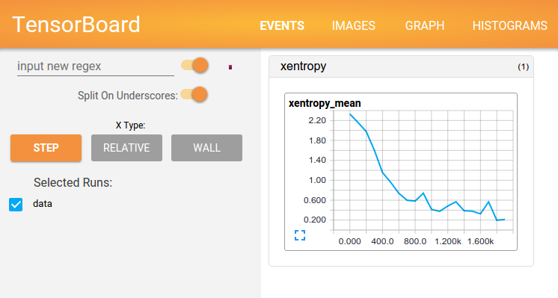
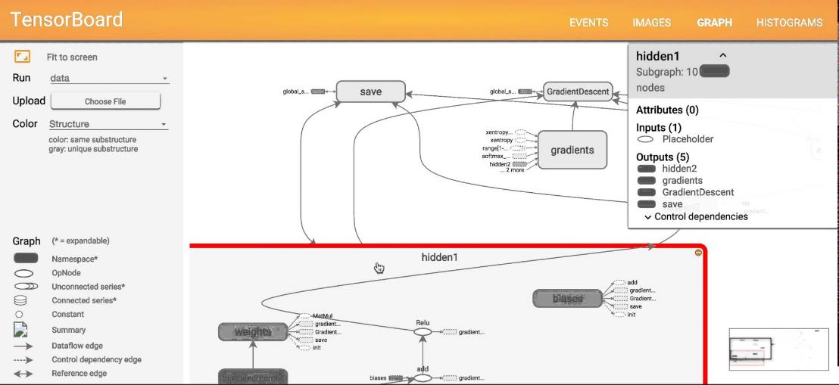
TensorBoard: Visualizing Learning

Slide 58
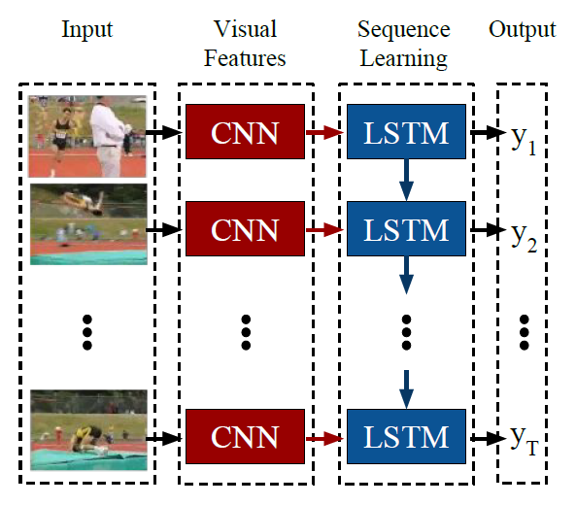
Remember you can combine different DL architectures
…sometimes CNNs are considered as feature extraction after RNN…

Slide 59
..for Eric Martín…
https://www.dukascopy.com/fxcomm/fx-article-contest/?Automated-High-Frequency-Trading-With=&action=read&id=1835
With the LSTM we don’t need to use any indicator because it’s going to build its own indicators that are totally hidden from us.
We only need to feed it the past tick to tick movements, one at a time, over the period we’ve chosen and it will predict the following movement.

Slide 60
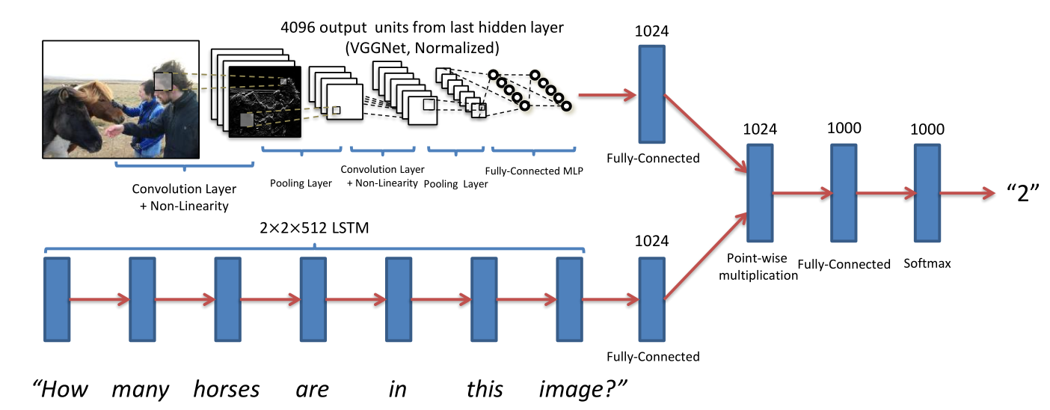
Remember you can combine different DL architectures
…sometimes CNNs and RNNs are combined for modelling
different multimodal sources…

Slide 61
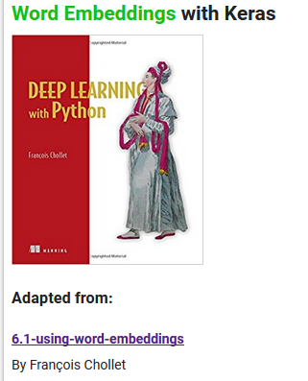
Embedding:
Indices by themselves, carry no semantic meaning
https://github.com/MasterMSTC/DeepLearning_TF_Keras
MSTC_Keras_RNN_3_Word_Embeddings.ipynb

Slide 62
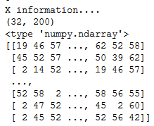
Embedings
Indices by themselves, carry no semantic meaning
This is where embedding comes in; more commonly known as word vector or word embedding.
http://sebastianruder.com/word-embeddings-1/

Slide 63
Embedings
In this case, we will
map the characters to low dimensional vectors of size state_size.
low-dimensional vector
(state_size = n_inputs)
http://sebastianruder.com/word-embeddings-1/

Slide 64
EMBEDDING LAYER
low-dimensional vector
GRU / LSTM
http://stackoverflow.com/questions/40184537/what-does-embedding-do-in-tensorflow

Slide 65
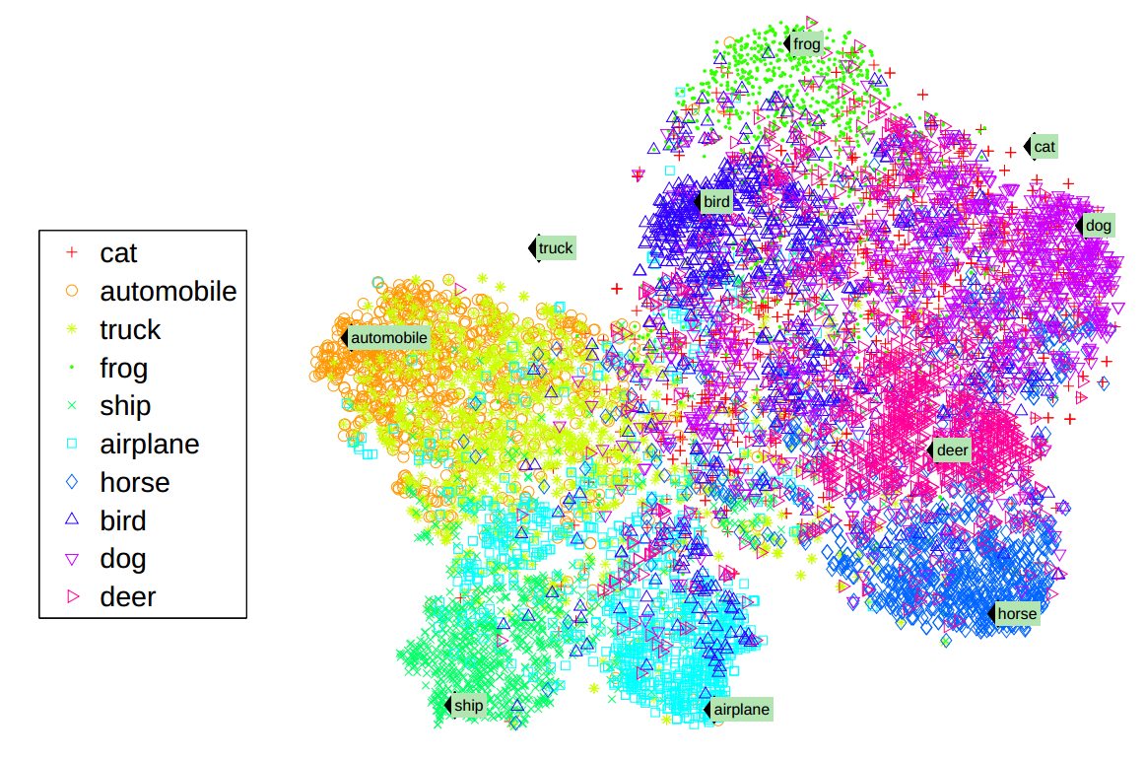
http://colah.github.io/posts/2014-07-NLP-RNNs-Representations/

Slide 66
See also:
Word2vec https://www.tensorflow.org/tutorials/word2vec
Vector space models (VSMs) represent (embed) words in a continuous vector space where semantically similar words are mapped to nearby points ('are embedded nearby each other')

Slide 67
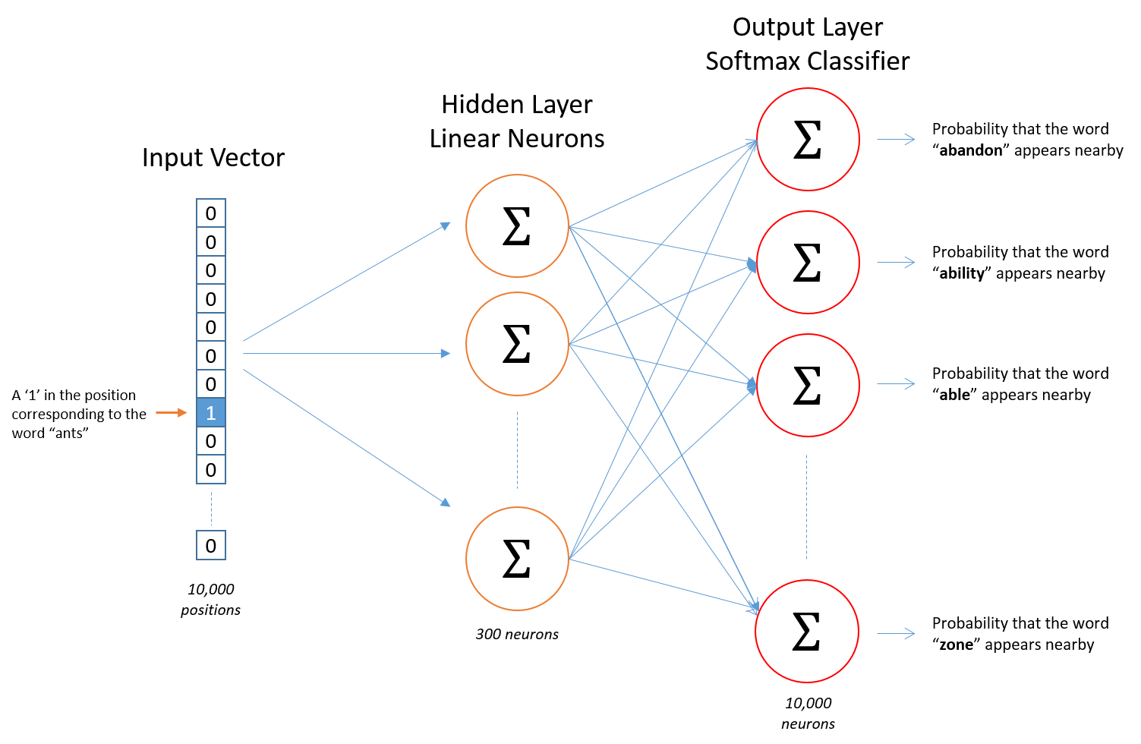
Word2Vec
https://www.youtube.com/watch?v=BD8wPsr_DAI
Sampled
Softmax
OHE

Slide 68

Word2Vec
https://ronxin.github.io/wevi/

Slide 69
References (I)
https://theneuralperspective.com/2016/10/04/05-recurrent-neural-networks-rnn-part-1-basic-rnn-char-rnn/
http://colah.github.io/posts/2015-08-Understanding-LSTMs/
http://www.wildml.com/2015/09/recurrent-neural-networks-tutorial-part-2-implementing-a-language-model-rnn-with-python-numpy-and-theano/
https://github.com/suriyadeepan/rnn-from-scratch
http://stats.stackexchange.com/questions/241985/understanding-lstm-units-vs-cells
http://monik.in/a-noobs-guide-to-implementing-rnn-lstm-using-tensorflow/
https://medium.com/@erikhallstrm/hello-world-rnn-83cd7105b767
http://suriyadeepan.github.io/2017-01-07-unfolding-rnn/
http://archive.eetindia.co.in/www.eetindia.co.in/VIDEO_DETAILS_700001601.HTM

Slide 70
References (II)
http://r2rt.com/styles-of-truncated-backpropagation.html
http://akkikiki.github.io/assets/LSTM+and+GRU.html
http://campuspress.yale.edu/yw355/deep_learning/
http://datascience.stackexchange.com/questions/12964/what-is-the-meaning-of-the-number-of-units-in-the-lstm-cell
http://stackoverflow.com/questions/37901047/what-is-num-units-in-tensorflow-basiclstmcell

